Slide 1
Trump Twitter Analysis
ISSS617: Python for Data Science
Group 6

Slide 2
Overview
Problem Outline
Datasets Used
Implementation
Data Preprocessing
Topic Modeling and Results
Sentiment Analysis and Results
Exploratory Data Analysis
Logistic Regression Classifier and Results
Future Work

Slide 3
Problem Statement
Donald Trump, the current POTUS, uses social media regularly to express opinions on world moving issues such as politics, military, markets, trade, economy, etc.
We believe that Trump’s electronic musings have a positive correlation with impacting global issues.
We are particularly interested in studying the impact of Trump’s tweets on financial markets.

Slide 4
Project Scope and Stakeholders
We are only studying the potential impact of Trump’s tweets on financial markets, specifically the US Treasury Yields market. We will run topic modelling algorithms to filter out irrelevant tweets.
A potential application of our solution could be to build a predictive market index that captures the impact of Trump’s tweets in real-time, for which stakeholders would include banks, brokerages, investors, etc.

Slide 5
Previous Work
JP Morgan’s analysts have created the “Volfefe Index”. For every 5 minutes after Trump tweeted with direct Fed references, the index showed “a rolling one-month probability” that each missive is market moving for treasury yields.
Citigroup has shown that Trump’s tweets are generally followed by volatile behavior across currency markets globally. They believe markets show more sensitivity to Trump’s continued tweeting with direct USD and Fed references.

Slide 6
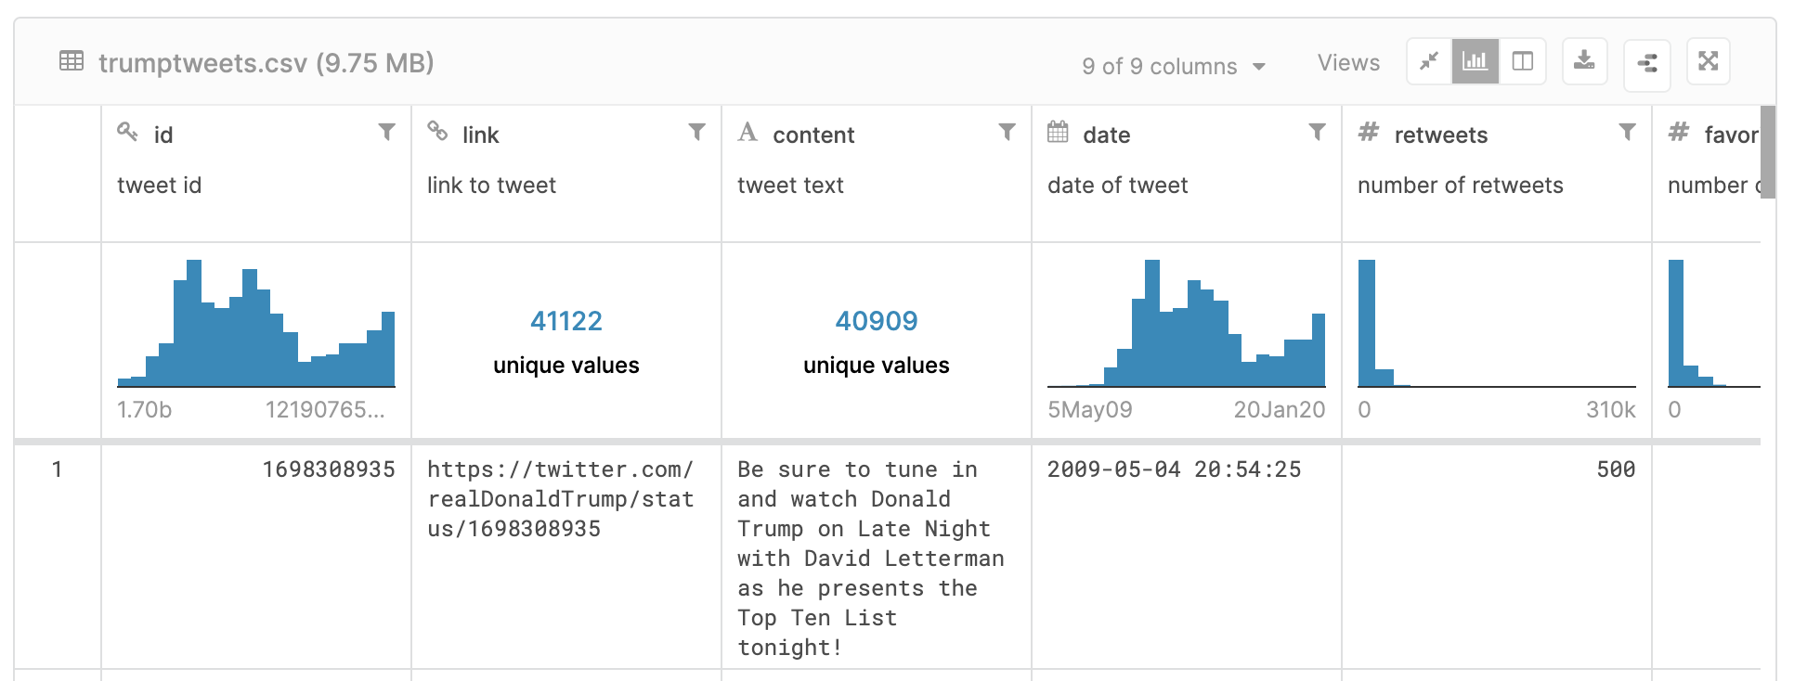
Datasets – Kaggle Tweets
Source: https://www.kaggle.com/austinreese/trump-tweets

Slide 7
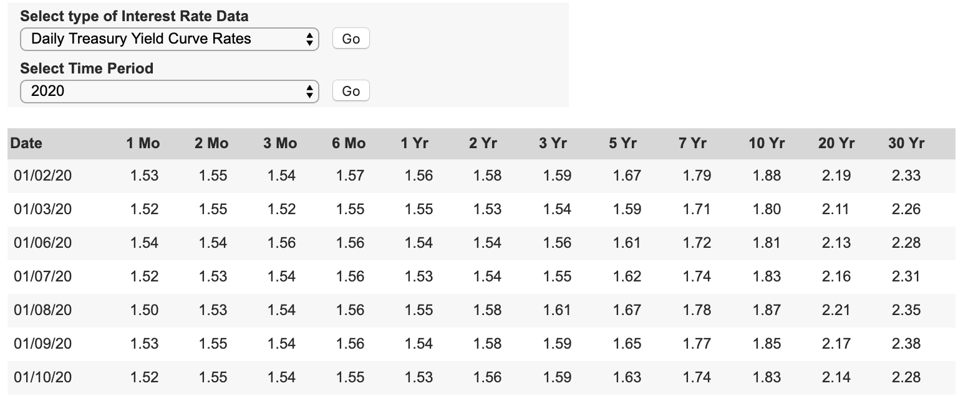
Datasets – US Treasury Yield Curve Rates
Treasury Yields data is taken for the same period for which Trump has been politically active on Twitter (2009-Present)
Source: https://www.treasury.gov/resource-center/data-chart-center/interest-rates/pages/textview.aspx?data=yield

Slide 8
Implementation
Data Preprocessing
Topic Modeling
Sentiment Analysis
Insights
Hypothesis Testing
Exploratory Data Analysis

Slide 9
Implementation - Libraries Used
Data Manipulation: numpy, pandas
Data Preprocessing: nltk, re, wordcloud
Topic Modeling: sklearn, pyLDAvis, pickle
Sentiment Analysis: vaderSentiment, TextBlob
Exploratory Data Analysis: matplotlib, seaborn

Slide 10
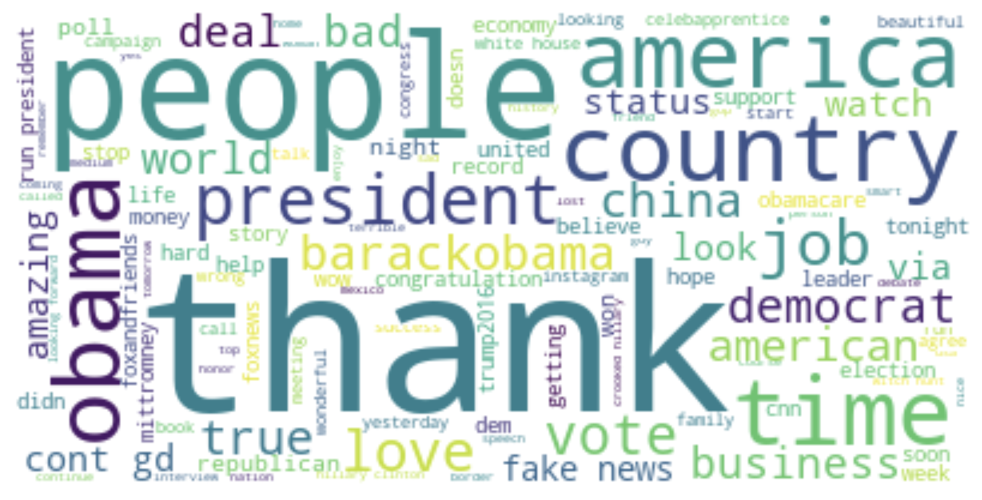
Data Preprocessing
Removing Hyperlinks
Removing Punctuations
Converting to Lowercase
Removing Stopwords
Word Net Lemmatization

Slide 11
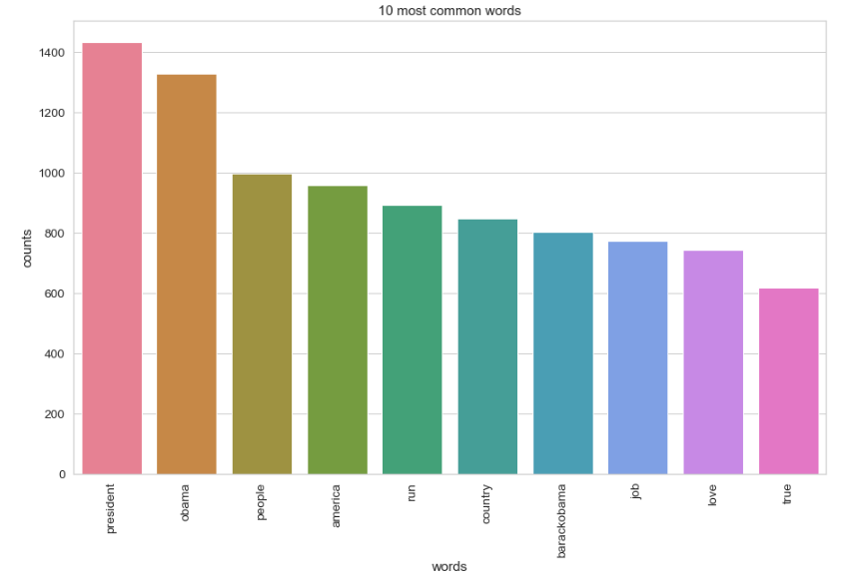
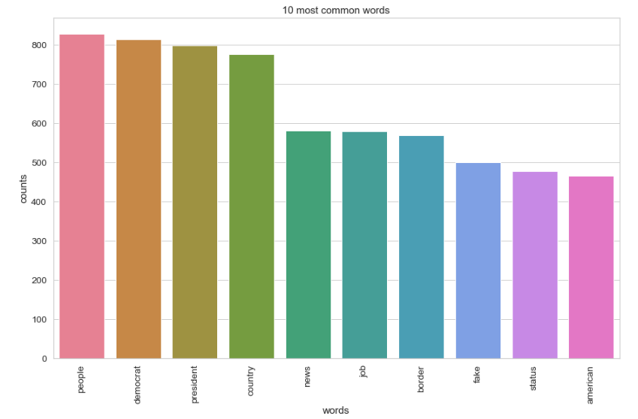
Topic Modelling – Top 10 Words
Top 10 2009-2016
President
People (140 times/year)
America
Run
Country
Barackobama
Job (114 times/year)
Love
True
Top 10 2017-2020
People (266 times/year)
Democrat
President
Country
News
Job (200 times/year)
Border (200 times/year)
Fake
Status
American

Slide 12
Topic Modeling – Major Topics before 2017
Campaign Related (about 30% tokens)
1:president, run
4: Hillary,Clinton, crooked
8:gop, party, republican
13: trump2016, makeamericangreat
15: campaign
18: Rubio, cruz, poll
20:foxandfriends, makeamericangreat
22:cnn, trump2016
Obama related (about 14% tokens)
2. Obamacare
9.barackobama
12.house, Obama,white
7. interview, china, barackobama, trade
Business related (about 15% tokens)
14: Hotel, tower,office
5: apprentice
3. apprentice, nbc, live
25: Miss, universe
Golf (3% tokens)
16: golf, club, scotland

Slide 13
Topic Modeling – Major Topics after 2017
Immigration (12% tokens)
Topic 1.border, wall, security, immigration
Topic 5. military, strong, crime, endorsement
Politics related(20% tokens)
Topic 6. republican, vote, witch hunt, impeachment
Topic 2. mueller, fbi, democrat, collusion, which hunt
Topic 8. Hillary, Schiff crooked, whisleblower
Topic 4. Fake news, medium, Russia
Trade related (15% tokens)
Topic 3.Country, china, billion, dollar, tariff, deal trade
Topic 7.China, market, stock, economy, unemployment
Topic 15. Court, trade, supreme, deal
Topic 18. Fed, dollar, billion, rate, people

Slide 14
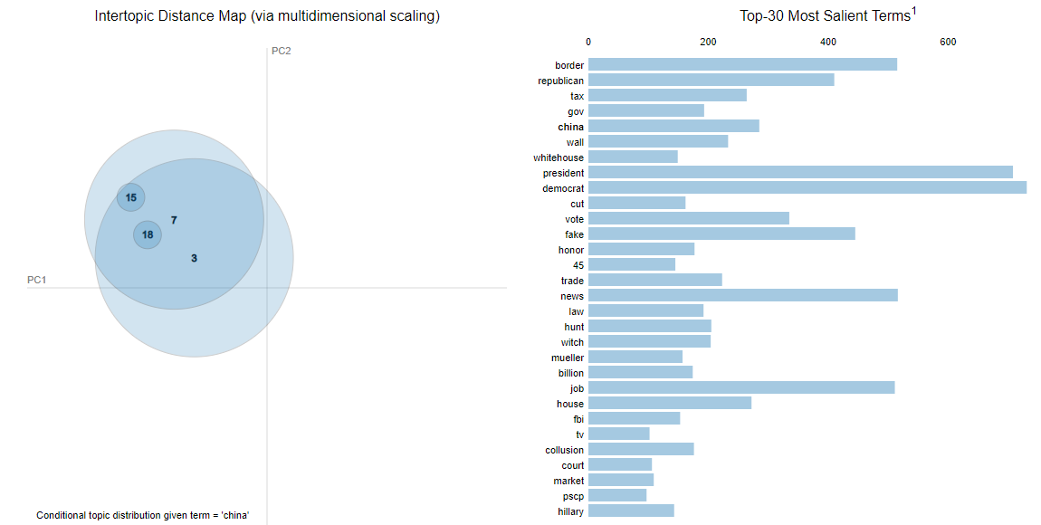
Topic Modelling – Major Topics : Trade
"most likely to affect market" - JPMorgan
“increasingly relevant (foreign exchange market)" - Citibank
Trade related
Topic 3.Country, china, billion, dollar, tariff, deal trade
Topic 7.China, democrat, stock, economy, unemployment
Topic 15. Court, trade, supreme, deal
Topic 18. Fed, dollar, billion, rate, people

Slide 15
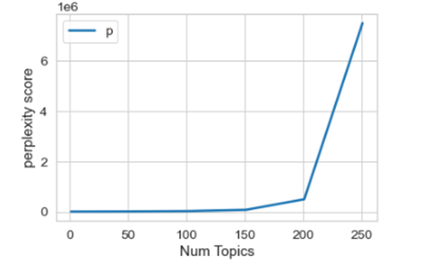
Topic Modeling – Perplexity
Perplexity vs. Interpretability
Less than 30 topics: difficult to interpret topic
75+ topics: topics too scattered, very small token size in some topics
30-75 topics: relatively low perplexity score and easy to find topics.

Slide 16
Sentiment Analysis
Sentiment Analysis is used to discover people’s opinions, emotions and feelings about a product or service.
Fine-grained Sentiment Analysis
If polarity precision is important to your business, you might consider expanding your polarity categories to include: Very positive, Positive, Neutral, Negative, Very negative
Multilingual Sentiment Analysis
Usually, when analyzing sentiments of texts, let’s say product reviews, when we want to know which particular aspects or features people are mentioning in a positive, neutral, or negative way. That's where aspect-based sentiment analysis can help, for example - "The battery life of this camera is too short", an aspect-based classifier would be able to determine that the sentence expresses a negative opinion about the feature battery life.
Aspect-based Sentiment Analysis
Emotion detection aims at detecting emotions, like happiness, frustration, anger, sadness, and so on. Many emotion detection systems use lexicons (i.e. lists of words and the emotions they convey) or complex machine learning algorithms..

Slide 17
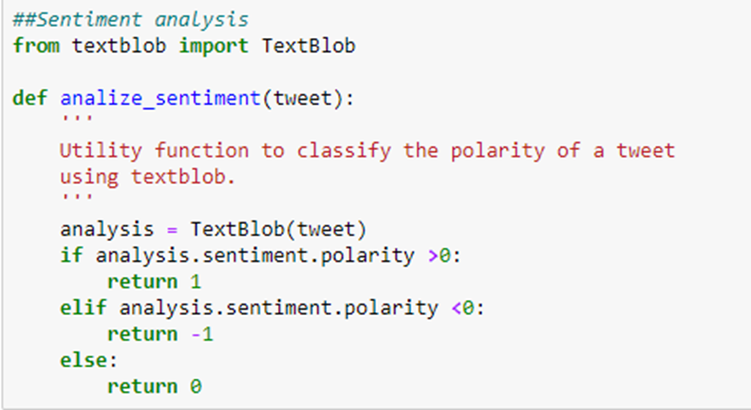
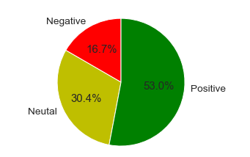
Sentiment Analysis – Code Snippet - Textblob
Polarity
[-1.0, 1.0]

Slide 18
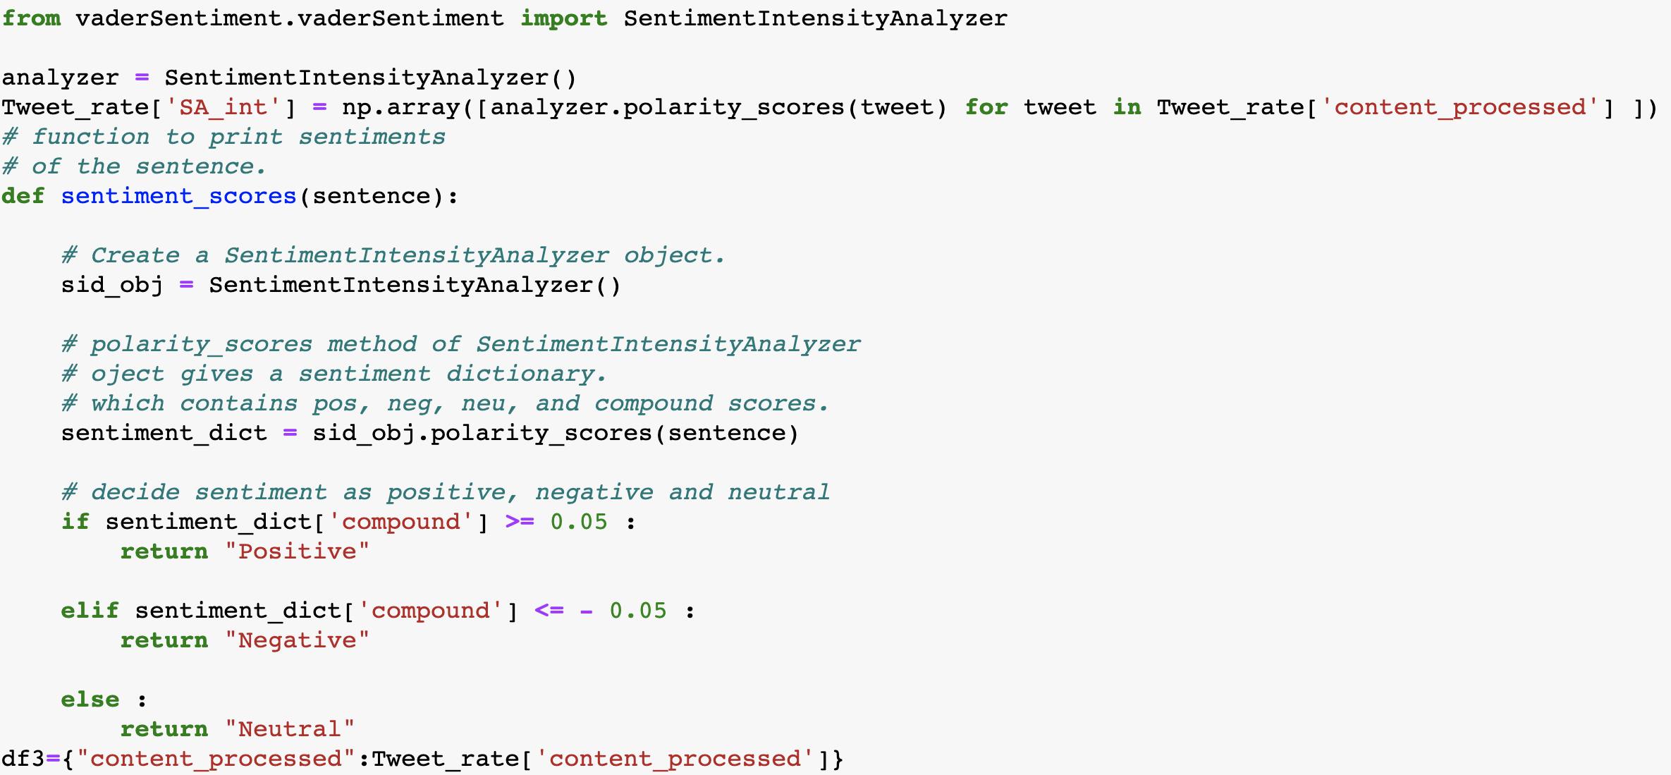
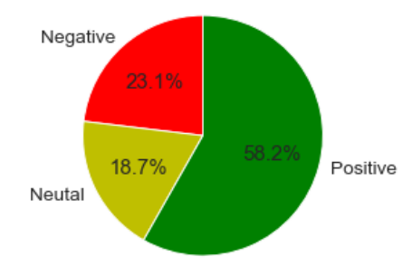
Sentiment Analysis – Code Snippet - Vader
Polarity
[-1.0, 1.0]

Slide 19
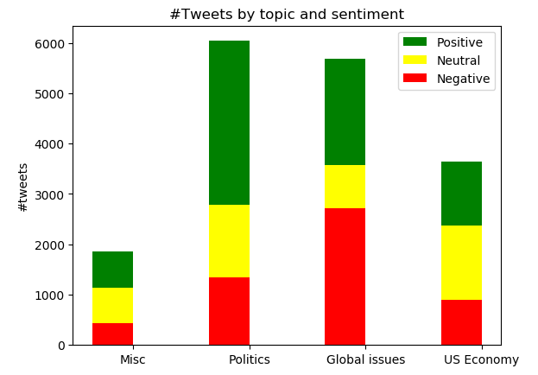
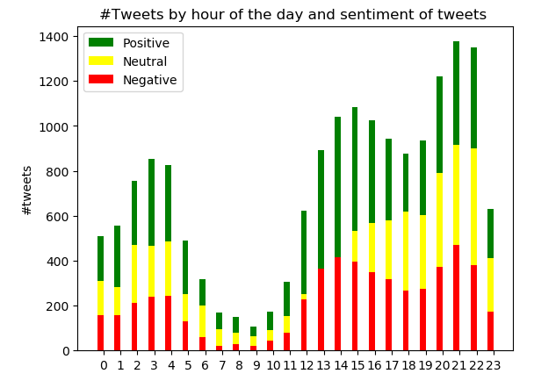
Exploratory Data Analysis
TODO
Top tweets are pertaining to politics
Majorly the tweets have been positive apart from more negative sentiment in Global issues
Trump tweets majorly in the second half of the day
Comparatively, the sentiment is more positive during the wee hours of the day

Slide 20
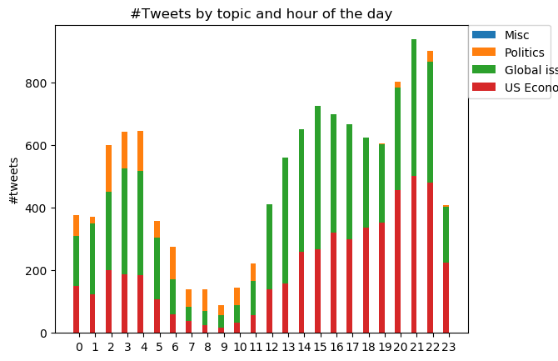
Exploratory Data Analysis – Spread of topics throughout the day
*Topic model based on entire dataset 2009-2020

Slide 21
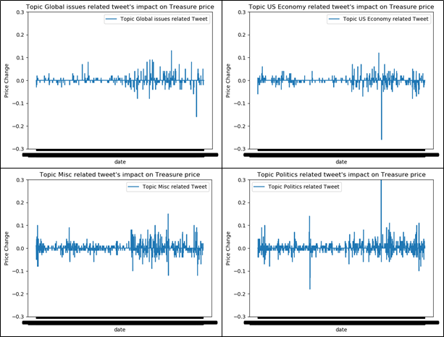
Exploratory Data Analysis - Tweet topic impact on Treasury price
Visualize the Treasure price movement impacted by tweet on a particular topic

Slide 22
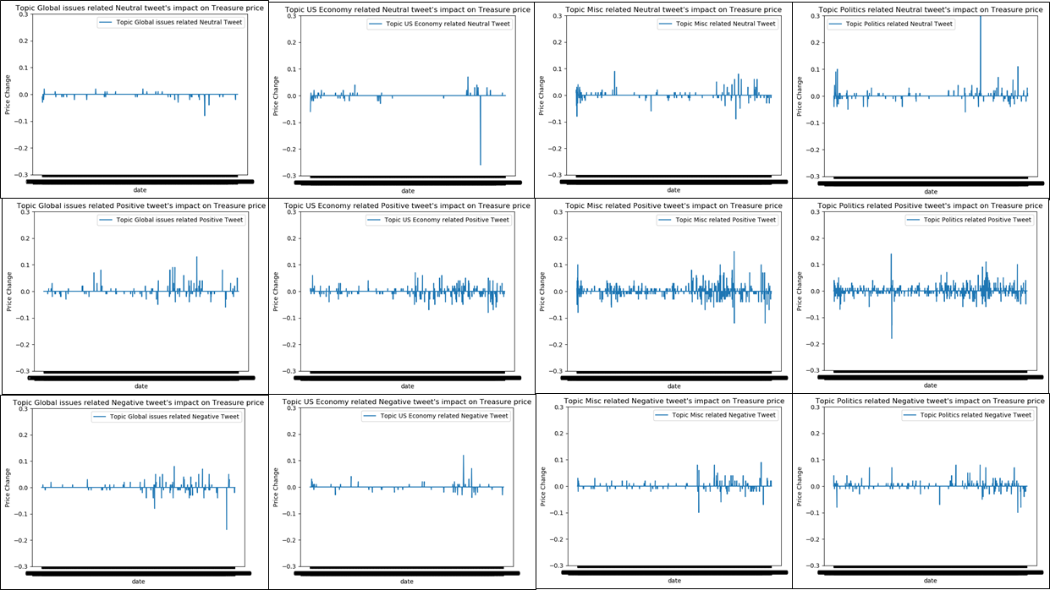
Exploratory Data Analysis – Tweet Sentiment impact on Treasury price
Visualize the Treasure price movement impacted by sentiment of the tweet on a particular topic

Slide 23
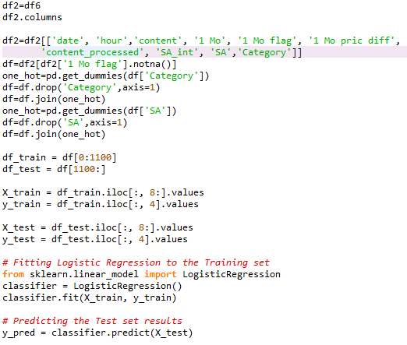
Logistic Regression Classifier- Model

Slide 24
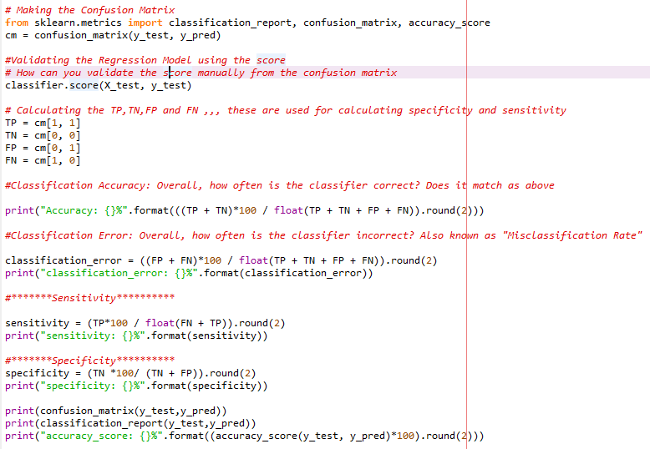
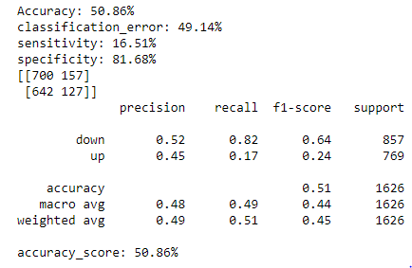
Logistic Regression Classifier- Evaluation

Slide 25
Future Work
Advanced Machine learning – To improvise on topic feature selection and hence improve the classification rate for the predictive modeling?
Per the exploratory analysis, Treasury prices seem to be comparatively much stable in comparison to Equity markets. Hence, we will extend our efforts to analyze the impact of POTUS Tweets on other financial markets
Build the next “Volfefe Index” ☺

Slide 26
THANKS!
Group 1-6
Akash Khowala
Amit Singla
Neel Chomal
Pankaj Bhootra
Wu Yinxiao

